Slide 1
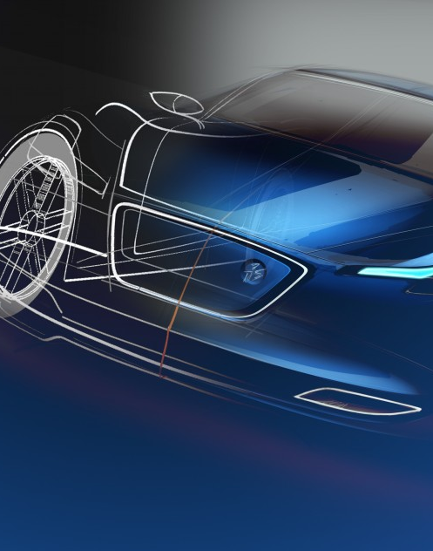
Cad Data management
IC Platform KIM Jihyeok (JKM21)
9 Nov 2022

Slide 2
CAD 개요
CAD Data Management 개요
Dassault Systemes Power’By Concept
Hands On

Slide 3
CAD

Slide 4
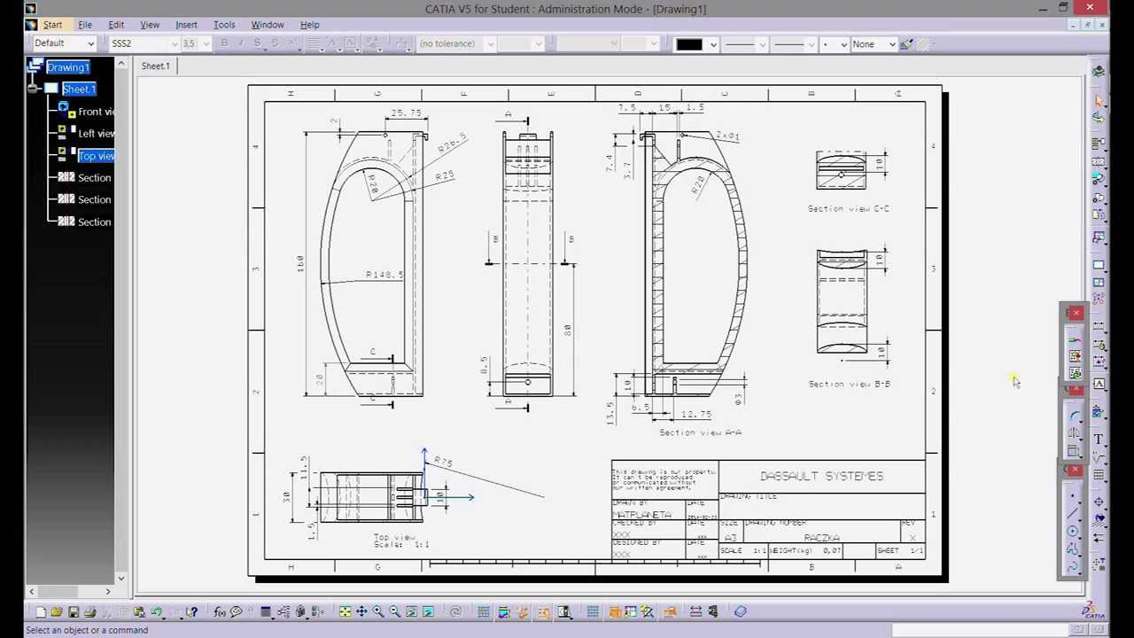




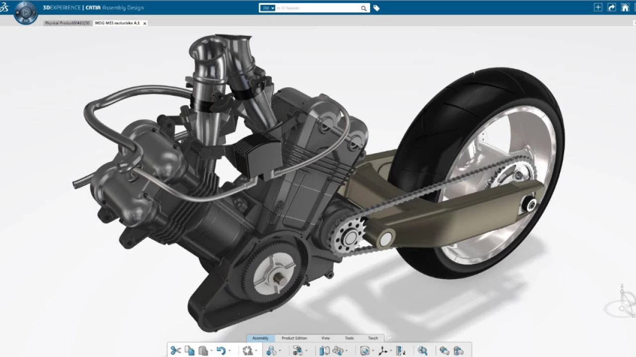




CAD
여러분은 CAD를 얼마나 알고 있나요?
CAD(Computer Aided Design)
컴퓨터를 이용해서 각종 설계 계산을 행하고 자동적으로 도면을 작성하는 시스템

Slide 5

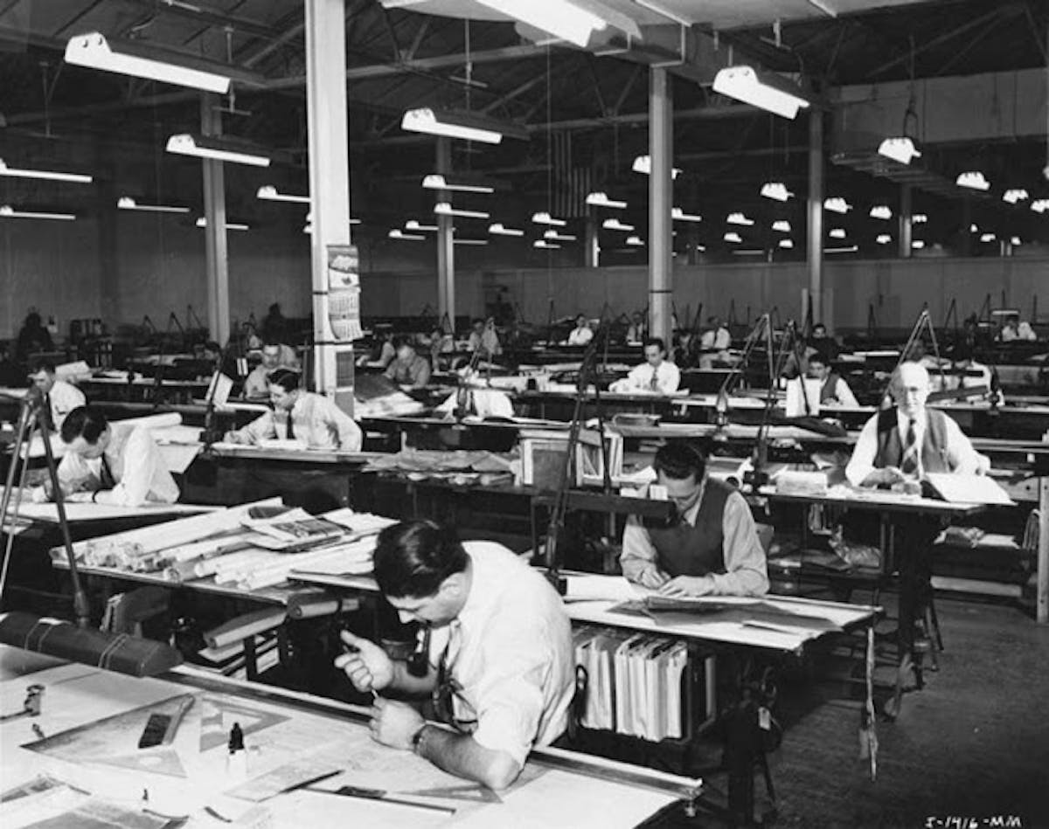
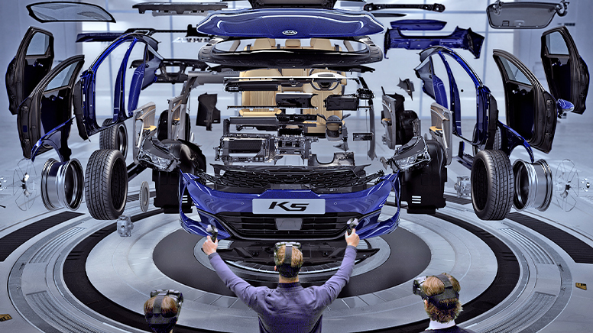
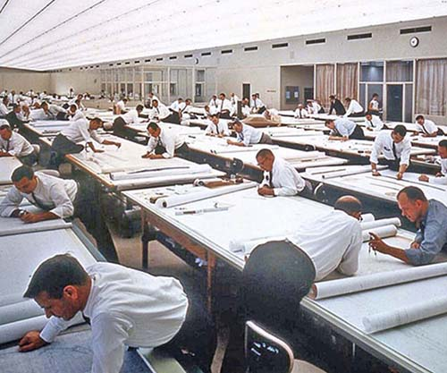

CAD(Computer aided design)
From hand drawing…
CAD(Design) DATA

Slide 6
CAD data management

Slide 7

CAD Data management
CAD 데이터 관리가 필요한 이유?
https://www.youtube.com/watch?v=pSBbq29FzA4&list=PLYytMYvkxYL2AeRtbiu3AUGQfZpOSi5l2&index=1

Slide 8
CAD Data management
Asynchronous Product Development
3DEXPERIENCE CATIA
File based CAD
Design Sync
E-CAD
Mechanical Engineer
Mechanical Engineer
Electronics/ Software Engineer
Electronics Engineer
Sync
Sync
Sync
Sync
Engineering Bill of Material
Product Engineer

Slide 9



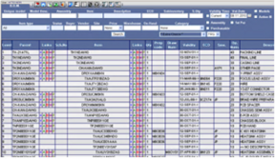
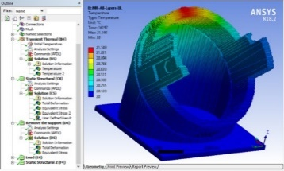

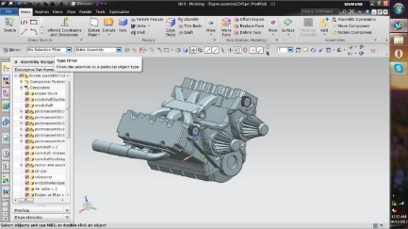




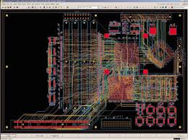

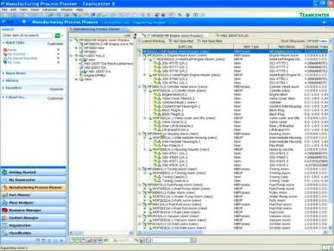

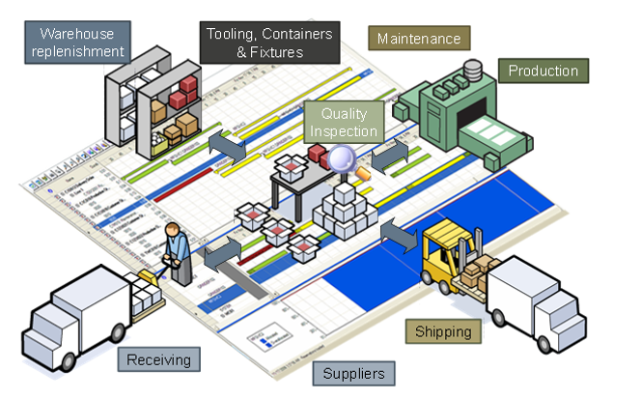
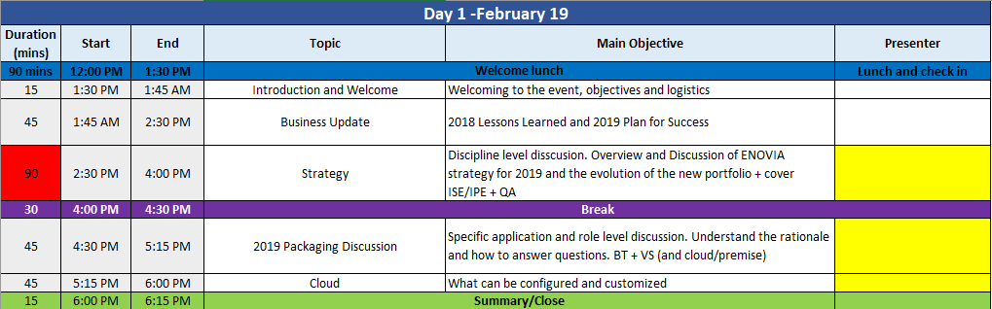

CAD Data management
BOM & Change
Unfortunate Users
Simulation
Designer
File-based
Operations
Manufacturing & Services
Configure & Plan

Slide 10
Dassault systemes Power’by concept

Slide 11

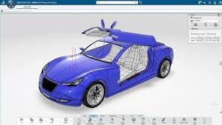


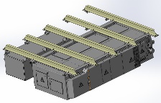
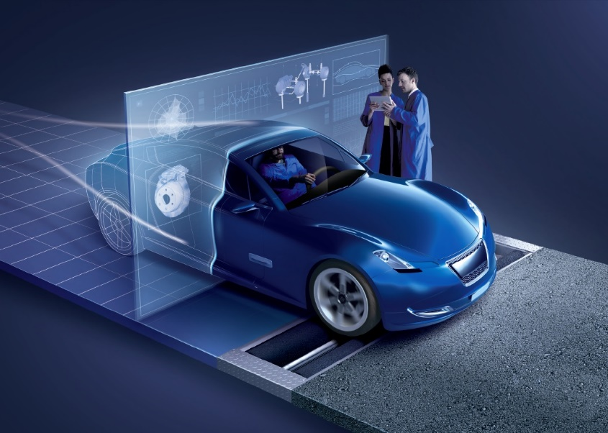


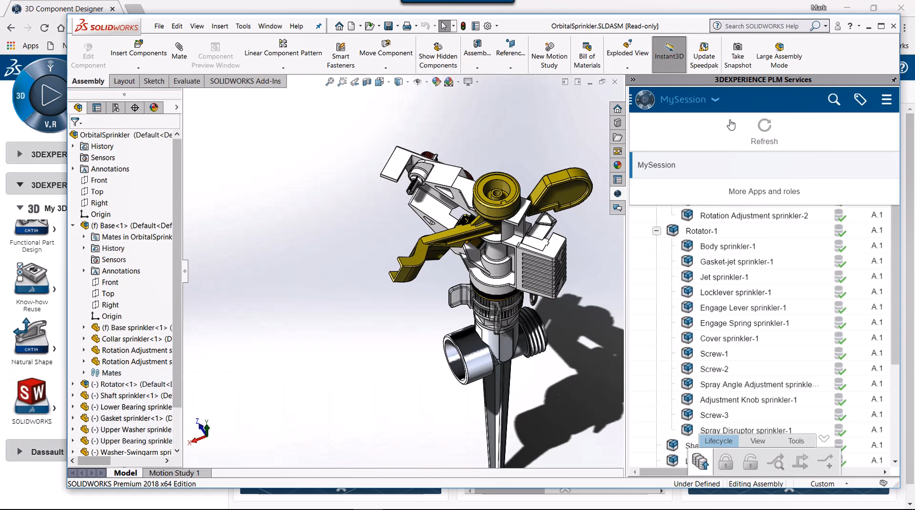


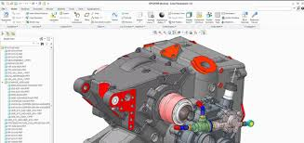
Multi Cad
Train, B
P/N : 900 - Make
Component_5, A
P/N : 005 - Buy
Assembly_1, A
Make
Product
Component_1, A
P/N : 001 - Make
It’s my CATIA V5 design
Assembly_2, A
Make
Component_2, A
P/N: 002 - Buy
Component_2, A
P/N: 002 - Buy
It’s my SOLIDWORKS
design
Assembly3, A
P/N 003: - Buy
Component_31, A
P/N : - Buy
Component_32, A
P/N : - Buy
It’s my CREO
design
Assembly4, A
P/N 003: - Buy
Component_41, A
P/N : - Buy
Component_42, A
P/N : - Buy

Slide 12
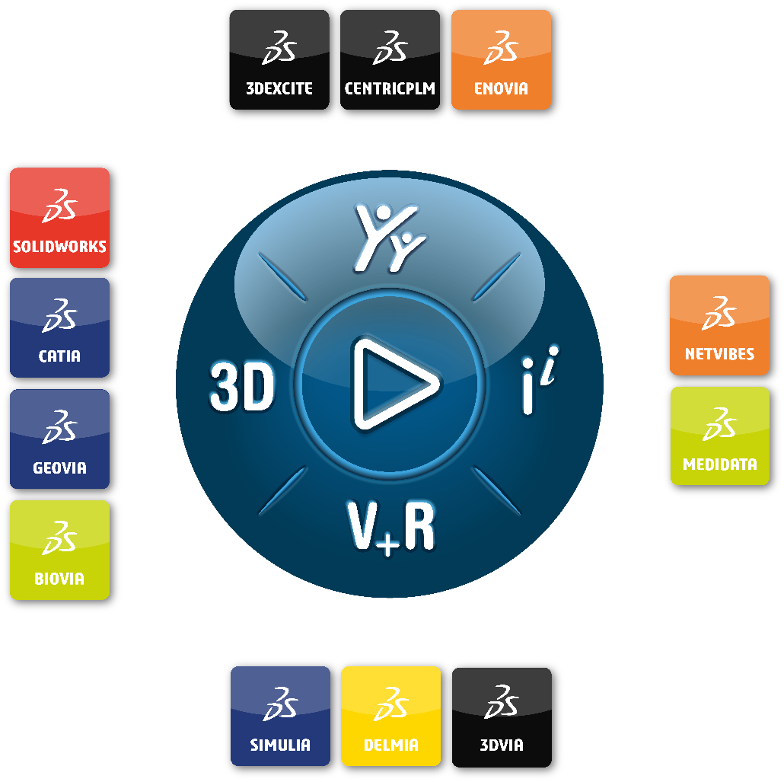



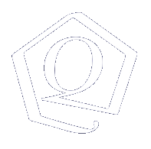






POWER’BY | connecting the legacy to the future
Notes:
So with POWER’BY we will connect our legacy systems, and even foreign CADs to our Platform thru One Single Data model and not simply integrate them in silos like our competitors do.

Slide 13



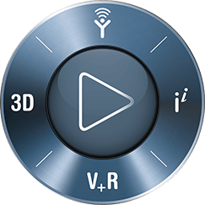

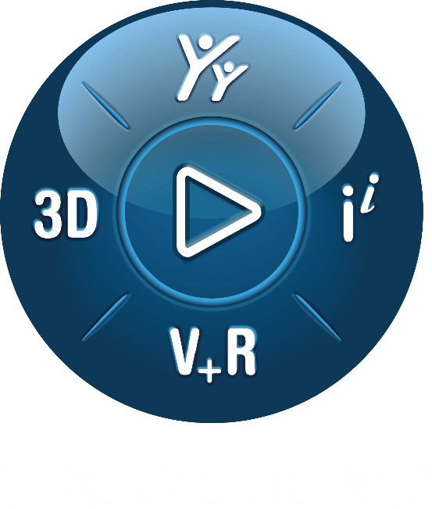
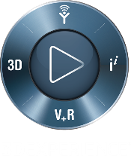






POWER’BY | connecting the legacy to the future
Methods
Design
X-CAD Design
Purchase
It is a strategy
that leverages different technologies
to connect legacy users & data to the 3DEXPERIENCE Business Platform
Sales
Industrial Design
CATIA V5 Users
Marketing
Engineering
Finance
Executive
comittee
SW Users
Manufacturing
Simulation
Legacy Manufacturing
Legacy Engineering
Notes:
POWER’By is one of them.
It is a strategy to Transition to 3DEXPERIENCE.
As we say in France, Rome was not built in one day. We still have a lot of customers out there with terabytes of legacy CADs, including our own (CATIA and Solidworks), so it is a way to preserve this legacy and our customers investments while leveraging the Power of the 3DEXPERIENCE

Slide 14
CAD Data management
Asynchronous Product Development
Synchronous Product Development
Engineering Data 통합 관리
3DEXPERIENCE CATIA
File based CAD
Design Sync
E-CAD
Mechanical Engineer
Mechanical Engineer
Electronics/ Software Engineer
Electronics Engineer
Sync
Mechanical
Engineer
Sync
Sync
Sync
SW
Engineer
Release
Engineer
Electrical
Engineer
Electronic
Engineer
Engineering Bill of Material
Product Engineer

Slide 15





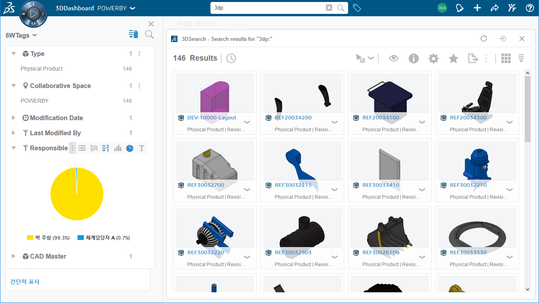
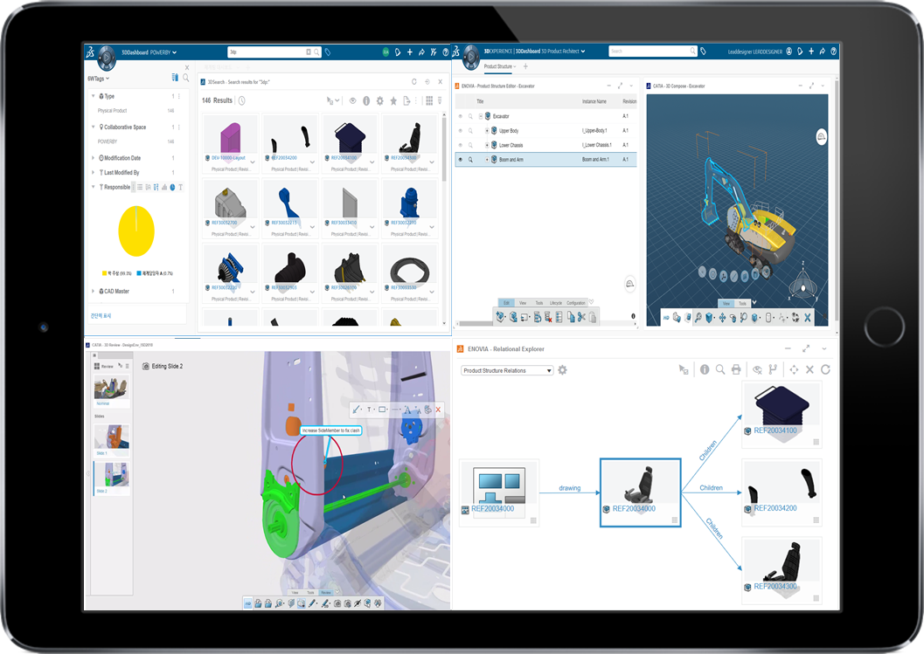
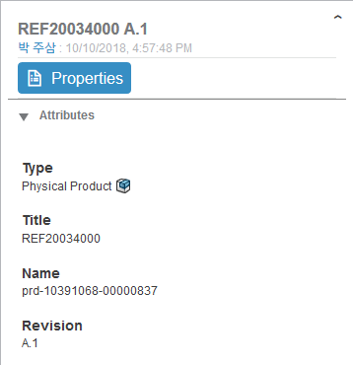

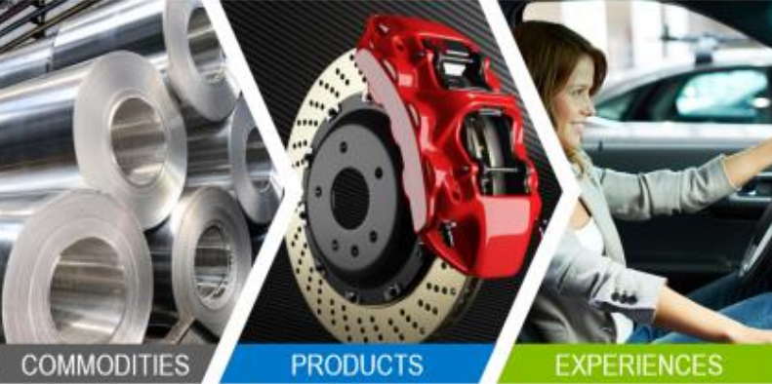





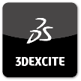
Power’by Major values
CONNECT
From CAD Part to Engineering Item
REVEAL
Web Mobile User Experience and
Advanced Collaboration
TRANSFORMATION
3DEXPERIENCE Transform processes
with Supplemental approach

Slide 16
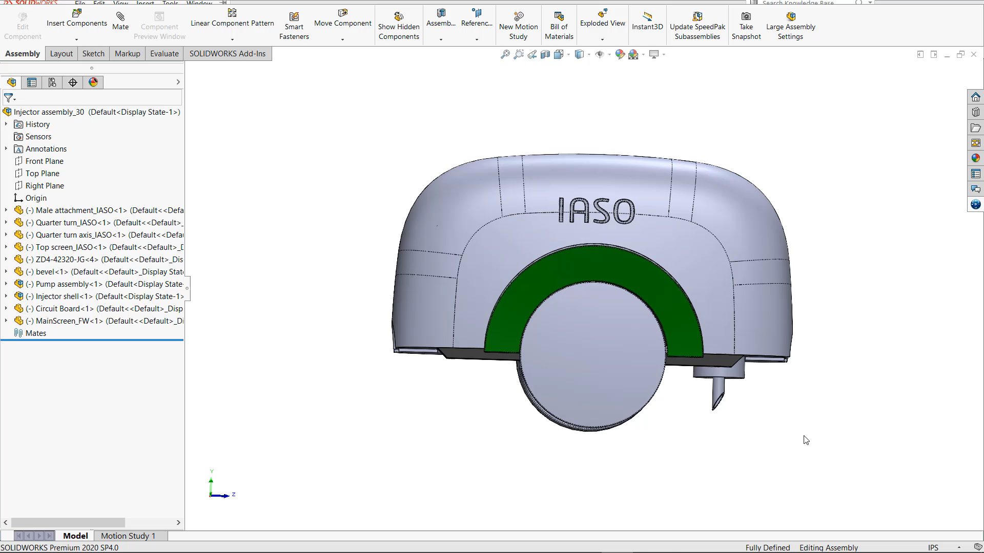
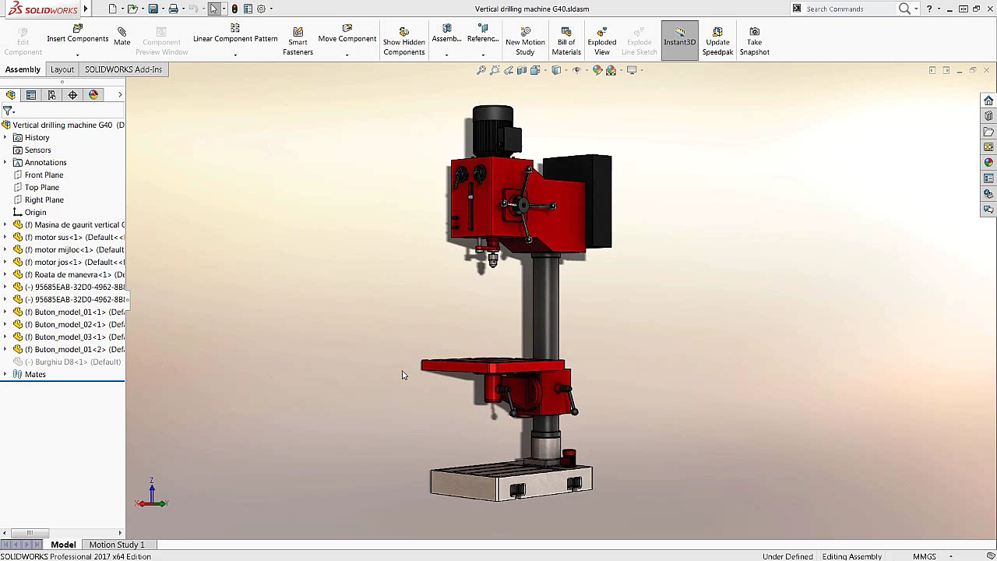
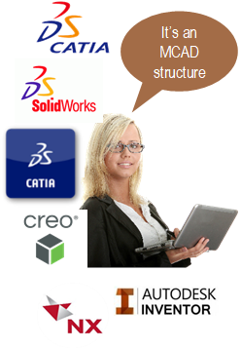
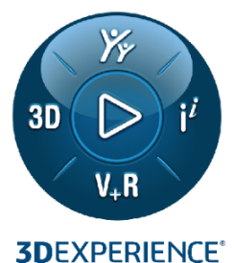
Power’by Major values
CONNECT … with Immersive User Experience, benefit for 3DEXPERIENCE platform values
CONNECT
Data
Driven
Collaborative Industry Innovator
Collaborative Business Innovator

Slide 17
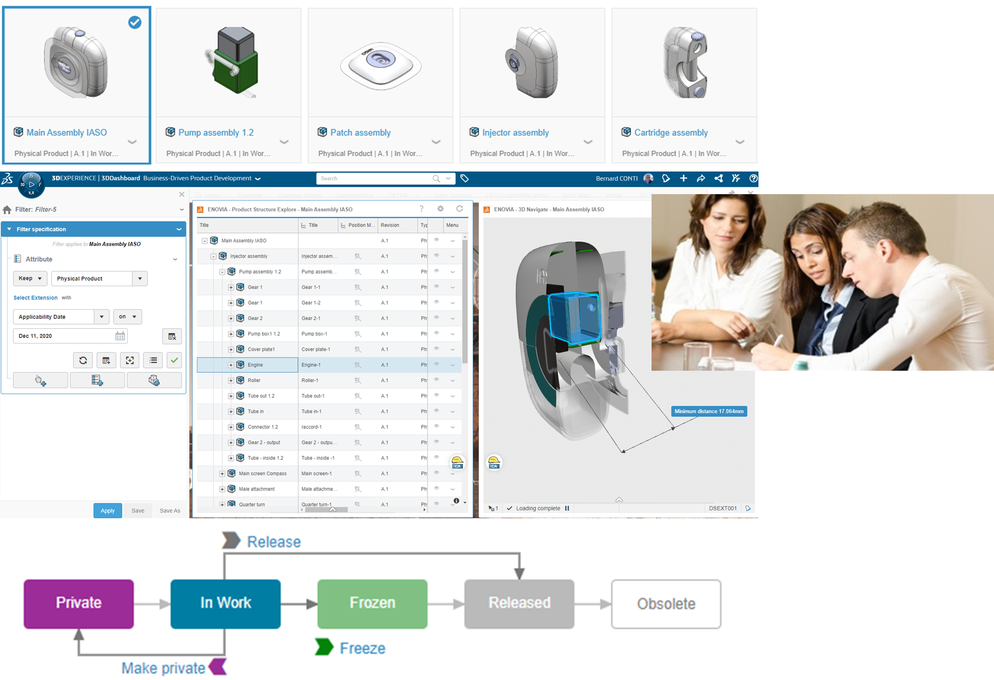
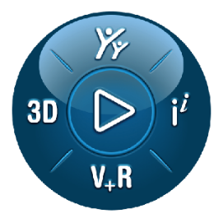
Power’by Major values
Manage Life Cycles … Anytime, Anywhere, Any Device
REVEAL
Data
Driven
Collaborative Industry Innovator
Collaborative Business Innovator

Slide 18
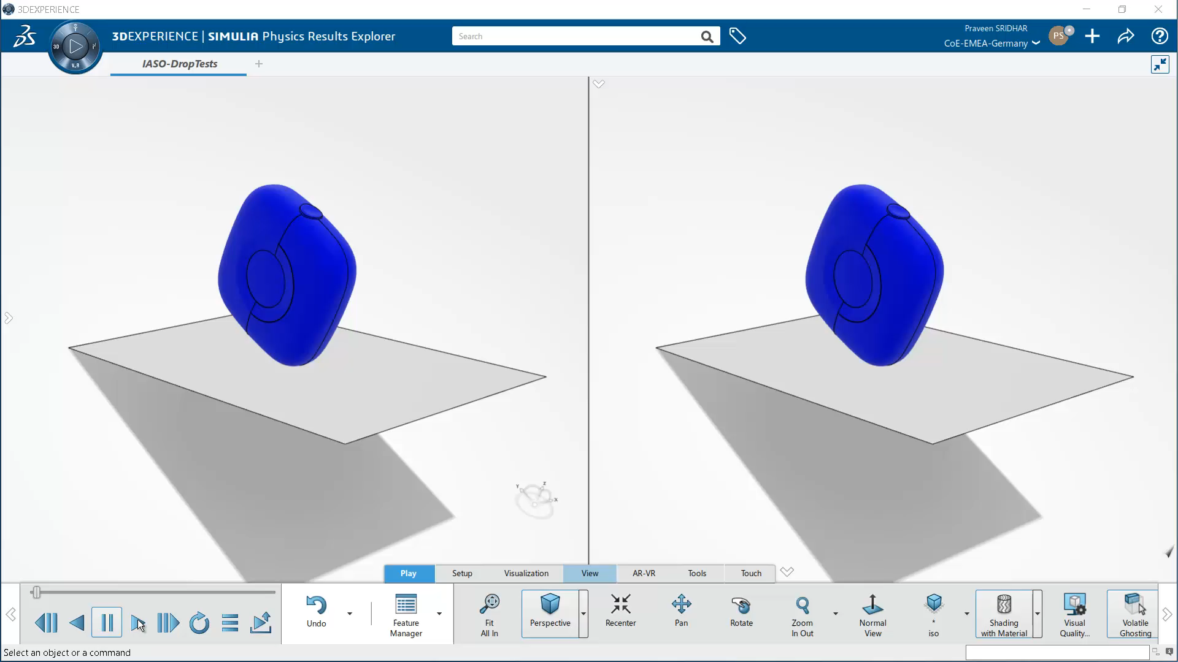
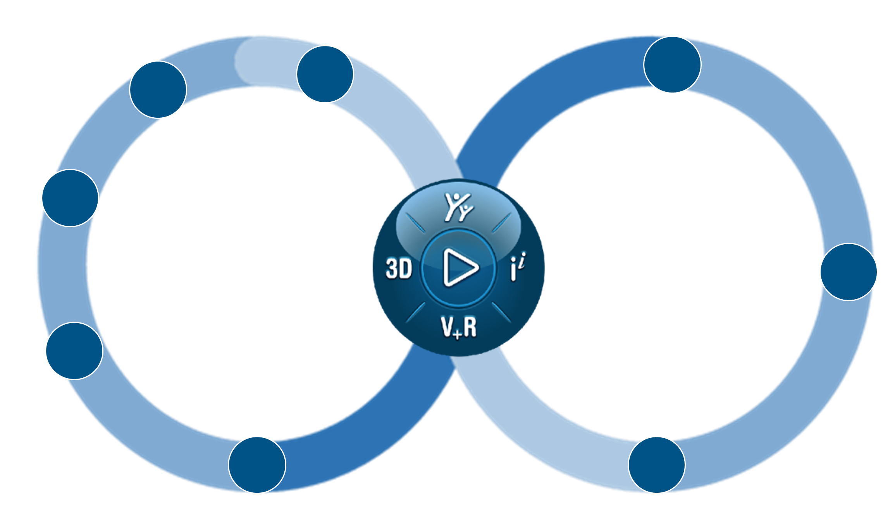
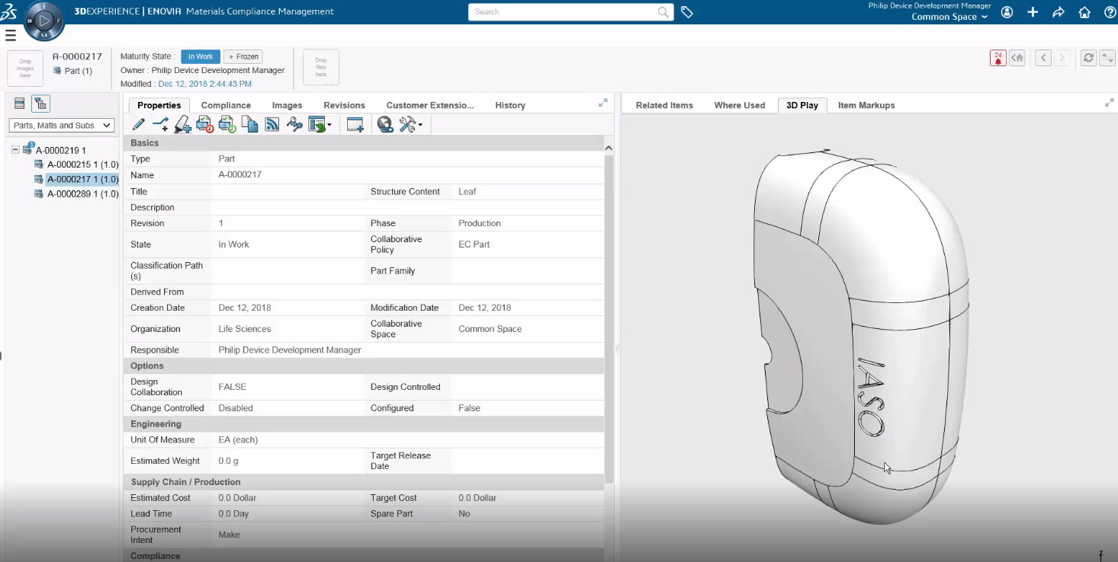
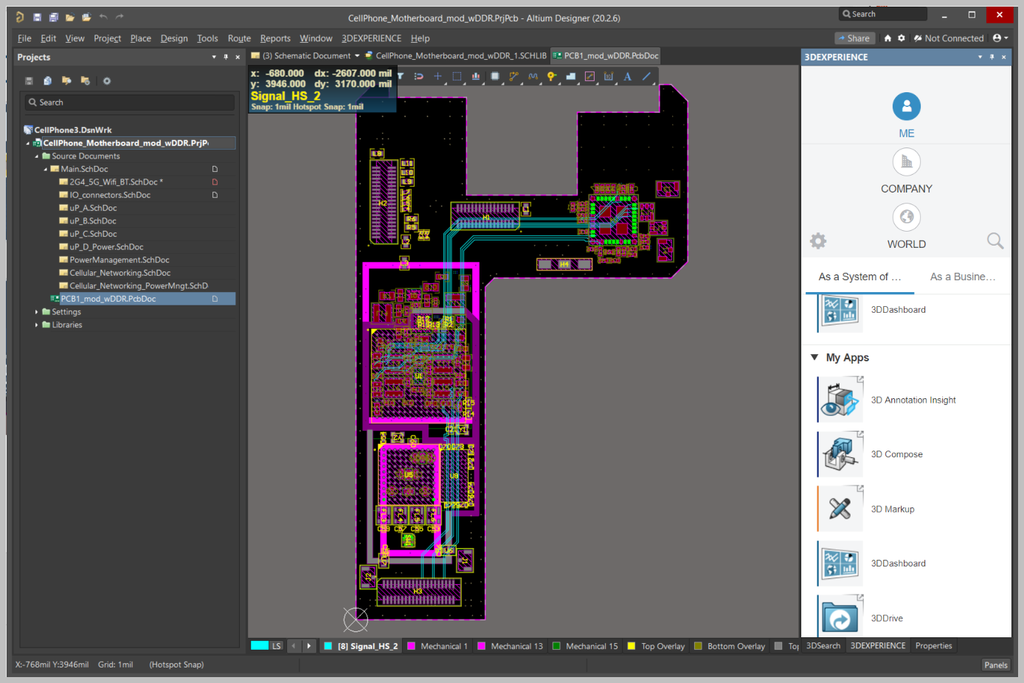


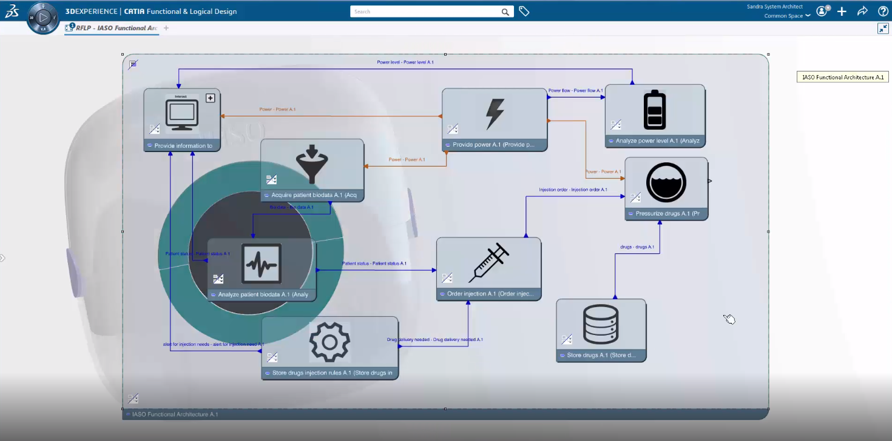
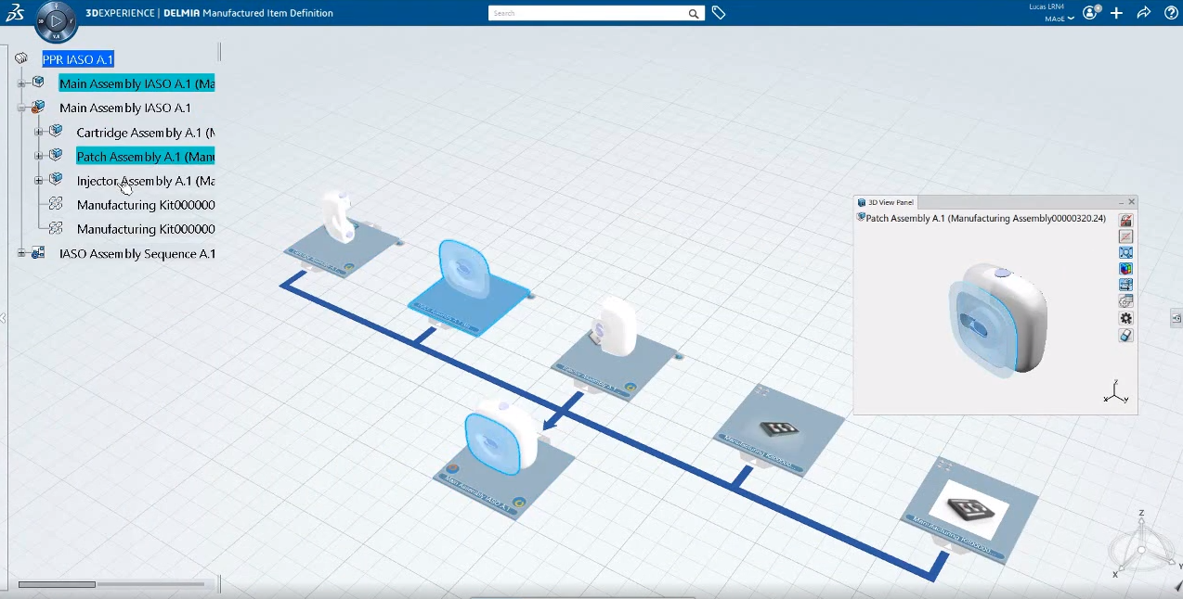




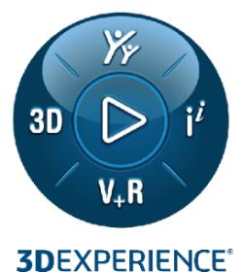
Power’by Major values
MODEL & SIMULATE EXPERIENCES
Model
Based
ENGINEERING
MECHATRONIC
TRANSFORMATION
SIMULATION
MANUFACTURING
MODEL SYSTEMS
Collaborative Industry Innovator
Collaborative Business Innovator

Slide 19






Customer Reference
“Changed Customer 3DS perception from CAD & PDM provider to an Innovation partner”
“Delivers Intuitive User Experience
ONE Click Access to Legacy IP”
“Allows New Working Behavior
Any Where, Any Time”
“ Facilitate adoption of Re Use, Change, Configuration “
“for the first time, we can explore the complete product engineering definition“
“Secure the legacy CAD investment, Avoid painful endless migrations”

Slide 20

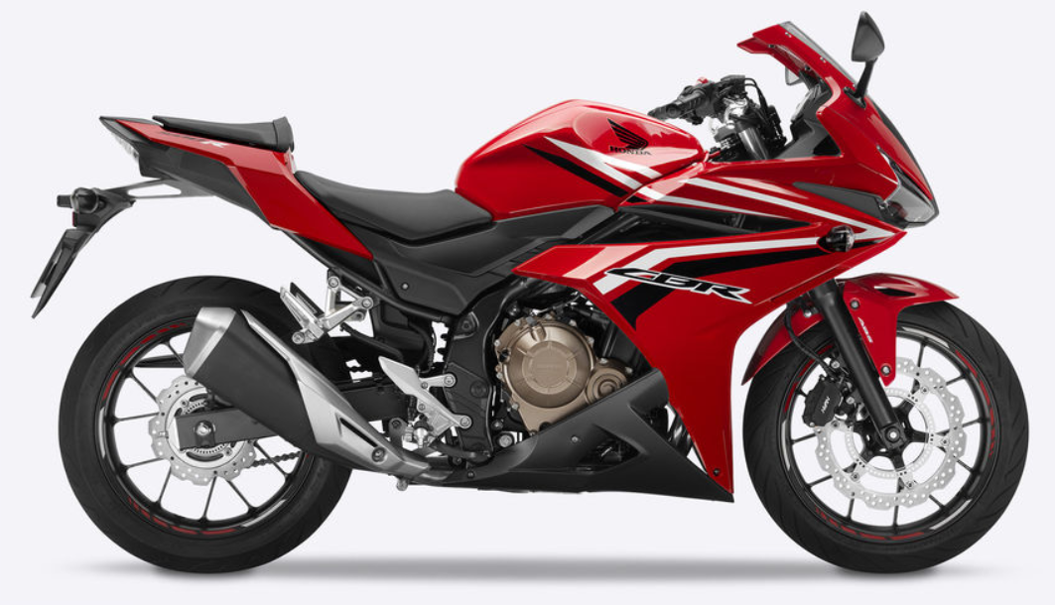
HONDA HGA (Motorcycles) | Reasons for changes
TODAY
TOMORROW
FILE BASED
3DEXPERIENCE
CONCEPT
DESIGN/ENGINEERING
CONCEPT
DESIGN/ENGINEERING
Dotted Information, Repetitive work, Knowledge/Knowhow inside Designers head
A complete Business Transformation
Driver 1: Reduce Designer’s non added value tasks by capitalizing and automatizing know-how in 3DEXPERIENCE platform
Driver 2: Real time information sharing between Engineering and Enterprise organizations
Driver 3: A single source of truth for Engineering Divisions collaboration, including overseas R&D Labs

Slide 21
HONDA | Key Take Away
From IT Driven Project to Business Process Re-Engineering
Reveal Customer CATIA V5 Intellectual Property
3DEXPERIENCE to capture and share knowledge and know how

Slide 22
Hands on

Slide 23
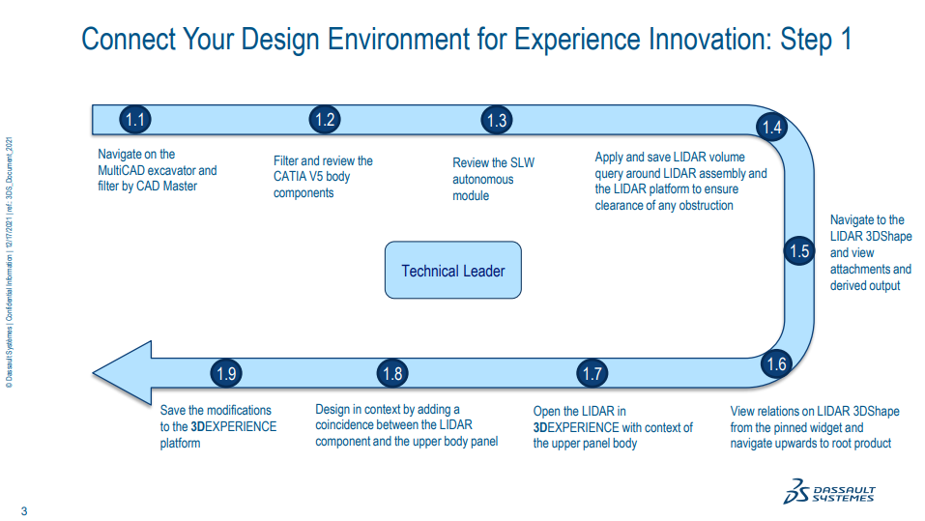
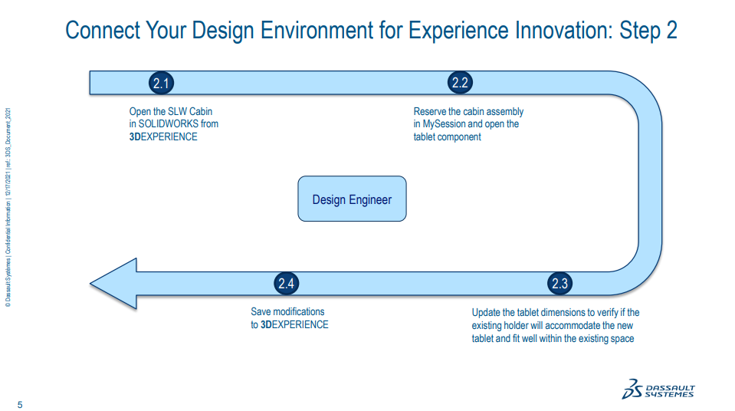
Hands on

